Slide 1
Day-6
SQL Normalization/Relationship/Query
By Aksadur Rahman
aksadur@yahoo.com

Slide 2
Agenda
Understanding the RDBMS
Database Normalization
NoSQL database
Select Statement
Filtering with where clause
Joining multiple conditions
Order By
Distinct
TOP/Like

Slide 3
What is SQL Server?
SQL Server is a relational database management system (RDBMS) developed by Microsoft. It is primarily designed and developed to compete with MySQL and Oracle database. SQL Server supports ANSI SQL, which is the standard SQL (Structured Query Language) language. However, SQL Server comes with its own implementation of the SQL language, T-SQL (Transact-SQL).
T-SQL is a Microsoft propriety Language known as Transact-SQL. It provides further capabilities of declaring variable, exception
SQL Server Management Studio (SSMS) is the main interface tool for SQL Server, and it supports both 32-bit and 64-bit environments.
Version History of SQL Server
Microsoft and Sybase released version 1.0 in 1989.
However, the partnership between these two ended in the early 1990s.
Microsoft maintained ownership rights to the name SQL Server.
Since the 1990s, subsequent versions of SQL Server have been released including SQL Server 2000, 2005, 2008, 2012, 2014, 2016, 2017, and 2019.

Slide 4
Database Normalization
What is Normalization?
Normalization is a database design technique that reduces data redundancy and eliminates undesirable characteristics like Insertion, Update and Deletion Anomalies. Normalization rules divides larger tables into smaller tables and links them using relationships. The purpose of Normalization in SQL is to eliminate redundant (repetitive) data and ensure data is stored logically.
Database Normal Forms
Here is a list of Normal Forms in SQL:
1NF (First Normal Form)
2NF (Second Normal Form)
3NF (Third Normal Form)
4NF (Fourth Normal Form)
5NF (Fifth Normal Form)
6NF (Sixth Normal Form)

Slide 5
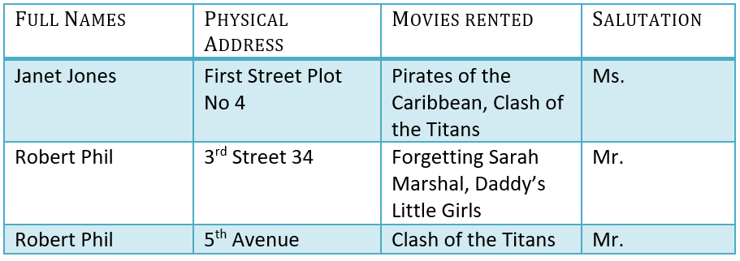
Database Normalization
Assume, a video library maintains a database of movies rented out.
Without any normalization in database.

Slide 6
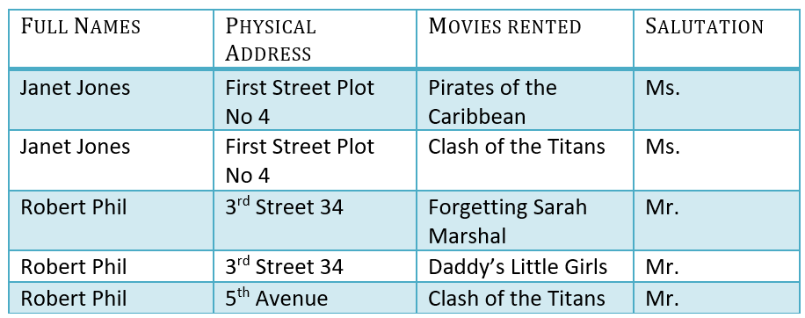
Database Normalization
1NF (First Normal Form) Rules
Each table cell should contain a single value.
Each record needs to be unique.

Slide 7

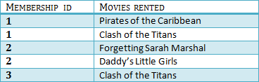
Database Normalization
2NF (Second Normal Form)

Slide 8

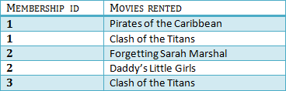

Database Normalization
3NF (Third Normal Form)

Slide 9
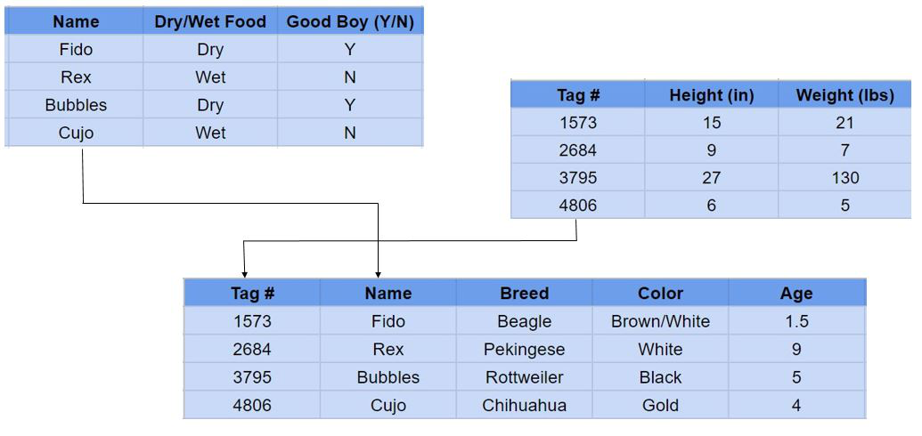
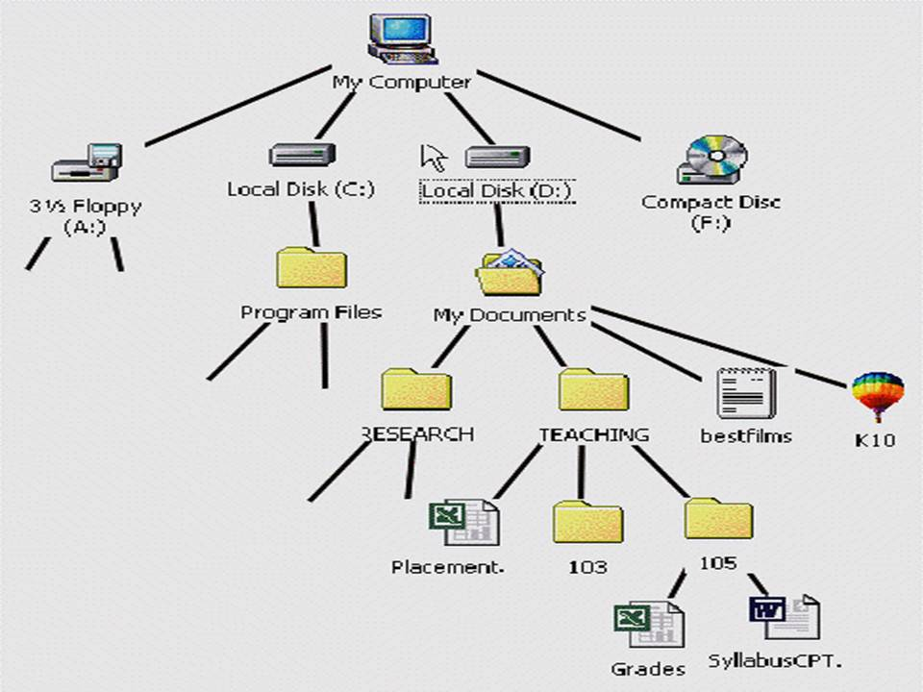
No SQL Database
What is NoSQL?
NoSQL Database is a non-relational Data Management System, that does not require a fixed schema. It avoids joins, and is easy to scale. The major purpose of using a NoSQL database is for distributed data stores
RDBMS Concept
NoSQL Concept

Slide 10
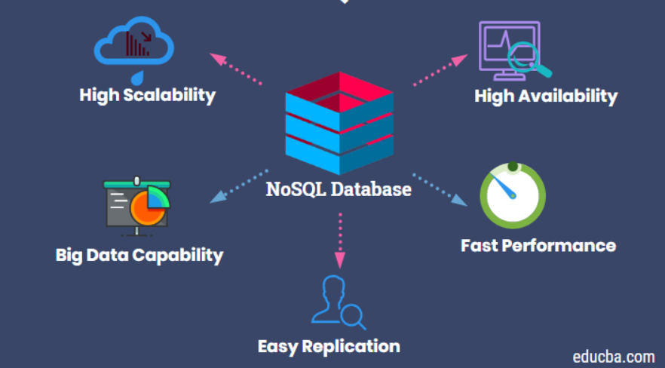
Why No SQL Database

Slide 11

No SQL Database
Amazon, Google, Netflix and Facebook Switched to NoSQL

Slide 12












No SQL Database
RDBMS Database
NoSQL Database

Slide 13
Query Practice
Customer
customer_id | first_name | last_name | phone | email | street | city | state | zip_code
1 | Debra | Burks | NULL | debra.burks@yahoo.com | 9273 Thorne Ave. | Orchard Park | NY | 14127
2 | Kasha | Todd | NULL | kasha.todd@yahoo.com | 910 Vine Street | Campbell | CA | 95008
3 | Tameka | Fisher | NULL | tameka.fisher@aol.com | 769C Honey Creek St. | Redondo Beach | CA | 90278
4 | Daryl | Spence | NULL | daryl.spence@aol.com | 988 Pearl Lane | Uniondale | NY | 11553
5 | Charolette | Rice | (916) 381-6003 | charolette.rice@msn.com | 107 River Dr. | Sacramento | CA | 95820
6 | Lyndsey | Bean | NULL | lyndsey.bean@hotmail.com | 769 West Road | Fairport | NY | 14450
7 | Latasha | Hays | (716) 986-3359 | latasha.hays@hotmail.com | 7014 Manor Station Rd. | Buffalo | NY | 14215
8 | Jacquline | Duncan | NULL | jacquline.duncan@yahoo.com | 15 Brown St. | Jackson Heights | NY | 11372
9 | Genoveva | Baldwin | NULL | genoveva.baldwin@msn.com | 8550 Spruce Drive | Port Washington | NY | 11050
10 | Pamelia | Newman | NULL | pamelia.newman@gmail.com | 476 Chestnut Ave. | Monroe | NY | 10950
11 | Deshawn | Mendoza | NULL | deshawn.mendoza@yahoo.com | 8790 Cobblestone Street | Monsey | NY | 10952
12 | Robby | Sykes | (516) 583-7761 | robby.sykes@hotmail.com | 486 Rock Maple Street | Hempstead | NY | 11550
13 | Lashawn | Ortiz | NULL | lashawn.ortiz@msn.com | 27 Washington Rd. | Longview | TX | 75604
14 | Garry | Espinoza | NULL | garry.espinoza@hotmail.com | 7858 Rockaway Court | Forney | TX | 75126
15 | Linnie | Branch | NULL | linnie.branch@gmail.com | 314 South Columbia Ave. | Plattsburgh | NY | 12901
16 | Emmitt | Sanchez | (212) 945-8823 | emmitt.sanchez@hotmail.com | 461 Squaw Creek Road | New York | NY | 10002

Slide 14
Select Statement
Select specific columns
select first_name, Phone, email, city from customers
Select all columns
select * from customers

Slide 15
Order By
Ascending
select * from customers order by first_name
select * from customers order by first_name asc
Descending
select * from customers order by first_name desc

Slide 16
Filtering with where clause
select first_name, Phone, email, city from customers
where city ='Monsey'
Joining multiple conditions
select first_name, Phone, email, city from customers
where city ='Monsey' and State = 'NY'

Slide 17
Distinct
select distinct last_name from customers
TOP N
select top 1 * from customers order by first_name desc
Like
select * from customers where first_name like 'j%'

Slide 18
Group by
select state, max(zip_code)
from customers
group by state

Slide 19
Practice
https://www.programiz.com/sql/online-compiler/
SQL Tutorial (w3schools.com)
https://www.stratascratch.com/

